Slide 1

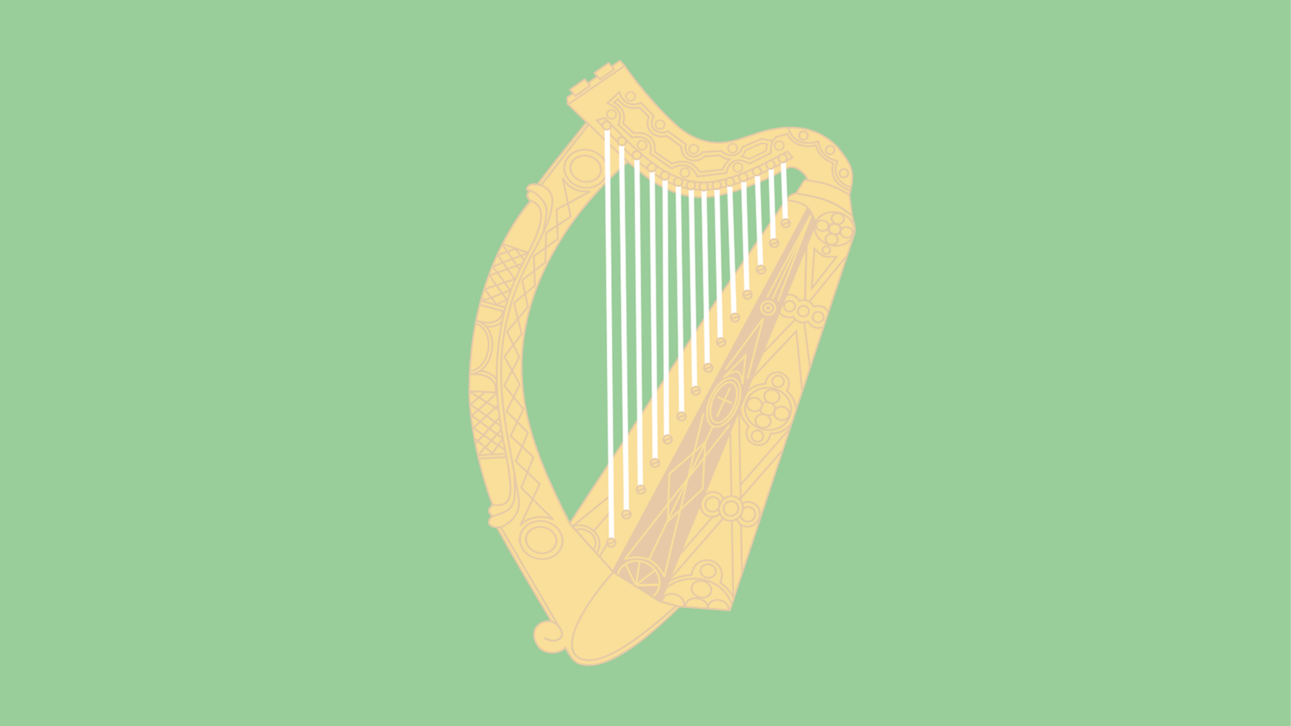


1798
Chapter 14
THE 1798 IRISH REBELLION
The 1798 Irish Rebellion
Strand Two: The History of Ireland
@MsDoorley

Slide 2
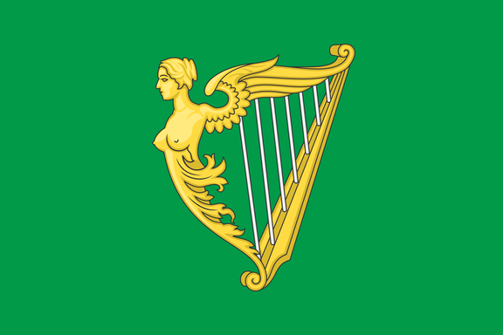
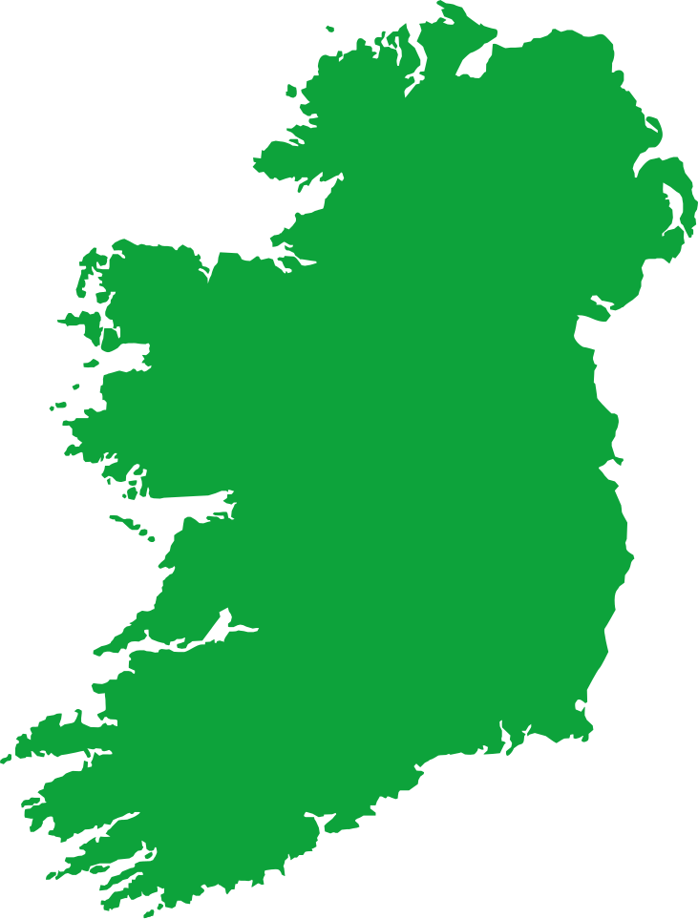
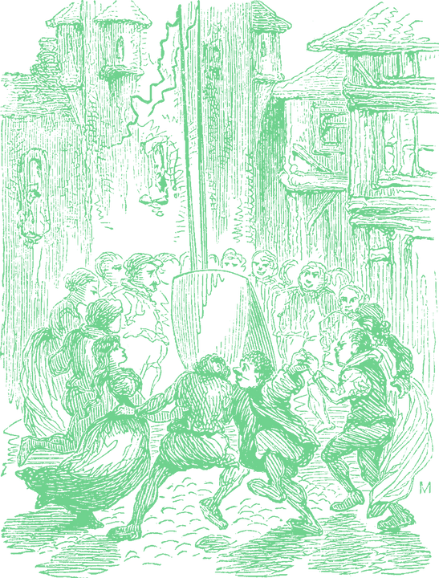
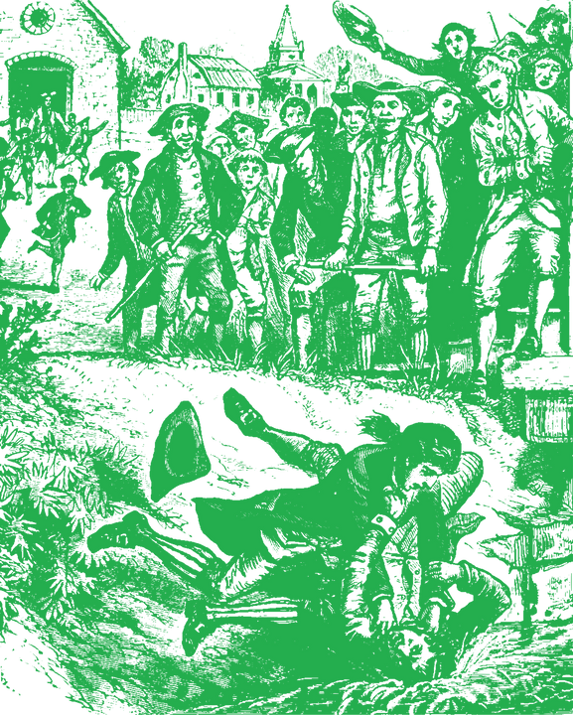

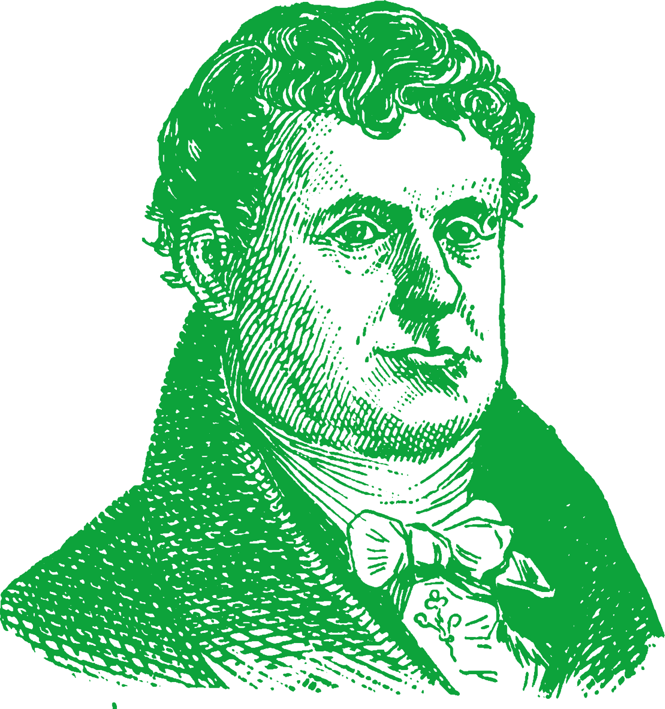

Chapter 14
THE 1798 IRISH REBELLION
October: Wolfe Tone is taken as prisoner by British forces and later commits suicide.
Roman Catholic Emancipation is led by Daniel O'Connell and is passed.
The French try to land at Bantry Bay but fail.
1791
1796
1798
1798
1800
1829
Chapter Fourteen: The 1798 Rebellion
Strand Two: The Nature of History
1840
Wolfe Tone creates the Society of the United Irishmen.
June: Rebellion takes place across Ireland. The most successive is in Wexford.
The Act of Union is passed, joining Ireland with Great Britain to create the United Kingdom.
Repeal Campaign is led by Daniel O'Connell but failed.
@MsDoorley

Slide 3
Learning Outcomes
  2.3 EXPLORE how the physical force tradition impacted on Irish politics, with particular reference to a pre-twentieth century example of a rebellion.
  1.2 CONSIDER contentious or controversial issues in history from more than one perspective and DISCUSS the historical roots of a contentious or controversial issue or theme in the contemporary world.
  1.3 APPRECIATE their cultural inheritance through recognising historically significant places and buildings and discussing why historical personalities, events and issues are commemorated.
Strand Two: The History of Ireland
Chapter Fourteen: The 1798 Rebellion
@MsDoorley

Slide 4
Introduction
By the late 1790s, revolutions had taken place in American and France. These revolutions had been fought for freedom and equality and against the ideas that kings had the power to rule as they wished, or that people should have to live under unjust governments. These concepts had a huge impact on Ireland. Inspired by these ideals, the United Irishmen emerged to challenge British rule in Ireland.
Strand Two: The History of Ireland
Chapter Fourteen: The 1798 Rebellion
@MsDoorley

Slide 5
1798
Chapter 14
14.1: THE CAUSES OF THE 1798 REBELLION
14.1: the causes of the 1798 rebellion
Strand Two: The History of Ireland
@MsDoorley

Slide 6
Christian Denominations Recap
We all know that Christianity is the belief in Christ as the Son of God. But why are there so many different “versions” of Christianity?
Throughout the history of Christianity, leaders in the religion have disagreed at various times. One such time was the Reformation that we covered at the end of last year. These disagreements are called “schisms”. There are four major ones in the history of Christianity such as the Reformation in 1517 and the Great Schism in 1054 [this split the religion between the West (Europe) and East (Turkey/Greece/Russia)].
The Reformation of 1517 led to the creation of Protestantism but it has also divided itself and has up to 188 different denominations (branches). Two of these are Anglicans (English) and Presbyterians (Scottish) Even though these two groups were both Protestants; they both saw themselves as having the “correct” belief in God. This led to divisions as we see in 1798 Ireland.
Strand Two: The History of Ireland
Chapter Fourteen: The 1798 Rebellion
@MsDoorley

Slide 7
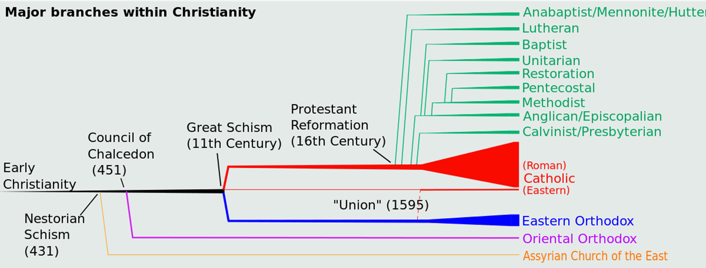
Strand Two: The History of Ireland
Chapter Fourteen: The 1798 Rebellion
Diagram taken from Artefact, 2nd Edition by Eimear Jenkinson and Gregg O'Neill (educate.ie)
@MsDoorley

Slide 8
The power of the Protestant Ascendancy
Since the Irish Plantations and the victory of the Protestant King William of Orange over the Catholic King James at the Battle of the Boyne in 1690, the island of Ireland was under the rule of the British Crown. Here was an Irish parliament in Dublin with limited powers and controlled by the Protestant Ascendancy (the wealthy, Anglican land-owning minority of Ireland). They were members of the Church of Ireland and the only people of Ireland who could become MPs (members of parliament). They owned 80% of the land yet only made up 15% of the population. Although they controlled Ireland, some Anglicans resented the limited power they had and the unfair trading system between the two islands.
Strand Two: The History of Ireland
Chapter Fourteen: The 1798 Rebellion
@MsDoorley

Slide 9
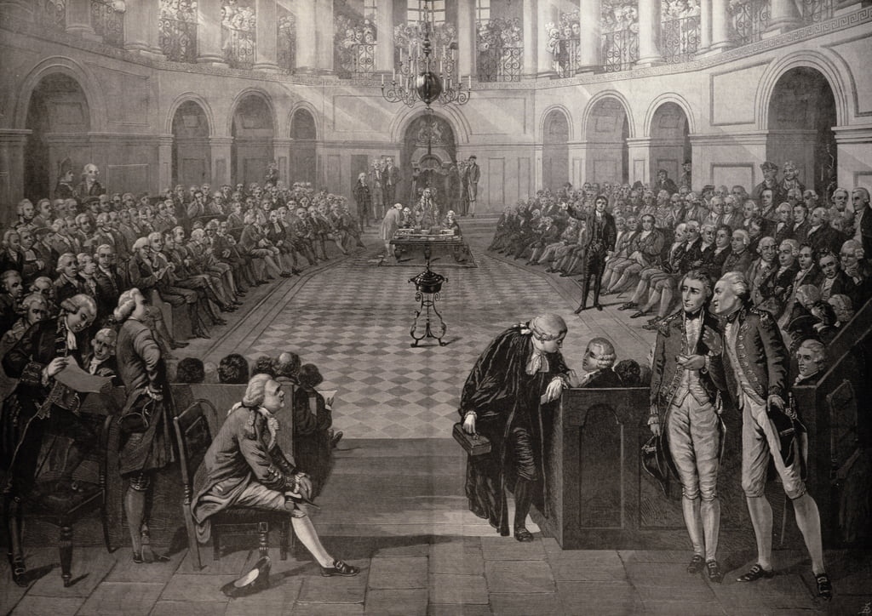
Strand Two: The History of Ireland
Chapter Fourteen: The 1798 Rebellion
Diagram taken from Artefact, 2nd Edition by Eimear Jenkinson and Gregg O'Neill (educate.ie)
@MsDoorley

Slide 10
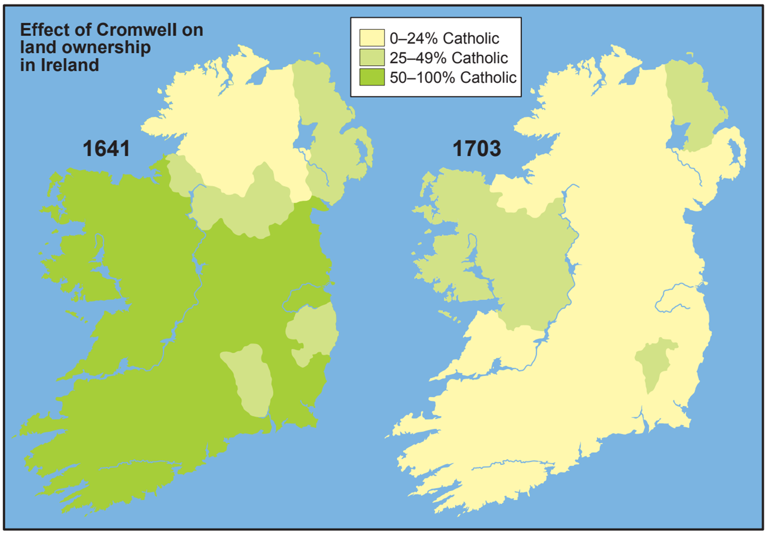
Strand Two: The History of Ireland
Chapter Fourteen: The 1798 Rebellion
Diagram taken from Artefact, 2nd Edition by Eimear Jenkinson and Gregg O'Neill (educate.ie)
@MsDoorley

Slide 11


Anglicans
15%
Catholics
15%
Presbyterians
10%
Strand Two: The History of Ireland
Chapter Fourteen: The 1798 Rebellion
Catholics
75%
Protestants
85%
Population by religion
Land Ownership by religion
@MsDoorley

Slide 12
The Position of Catholics
Catholics made up 75% of the population, yet owned only 15% of the land and had no political power. To protect the interests of the Protestant ruling classes, the British passed the Penal Laws which discriminated against Catholics. The aim of these laws were to keep millions of Catholics poor and uneducated with little chance of making any progress in life. These included:
  Catholics were not allowed vote or sit in parliament.
  Catholic priests, bishops and orders were banned.
  Catholics could not open or attend schools.
  Catholic-owned land had to be divided equally between all sons upon a father’s death.
  Catholics had to pay tithes to the Church of Ireland (Protestant) clergy.
  Catholics could not buy land from a Protestant.
  Catholics could not become a barrister, judge or solicitor.
  Catholics could not live in towns.
While some of the worst laws were repealed in the 1770s, Catholics still had no say in how they country was run. By the 1790s, most Catholics were poor, under-educated tenant farmers who resented the high rents and tithes they had to pay. In rural areas, secret groups such as the Whiteboys savagely attacked Protestant landlords.
Strand Two: The History of Ireland
Chapter Fourteen: The 1798 Rebellion
@MsDoorley

Slide 13
The Position of Presbyterians
Presbyterians were mainly Scottish settlers in Ulster, particularly around Belfast and made up 10% of the population. They were known as dissenters at the time because they disagreed with the official Protestant Church of Ireland (Anglicanism). Although they were not subjected to the harshest of the Penal Laws because they were still Protestant, they were not allowed to vote or sit in parliament.
Strand Two: The History of Ireland
Chapter Fourteen: The 1798 Rebellion
@MsDoorley

Slide 14
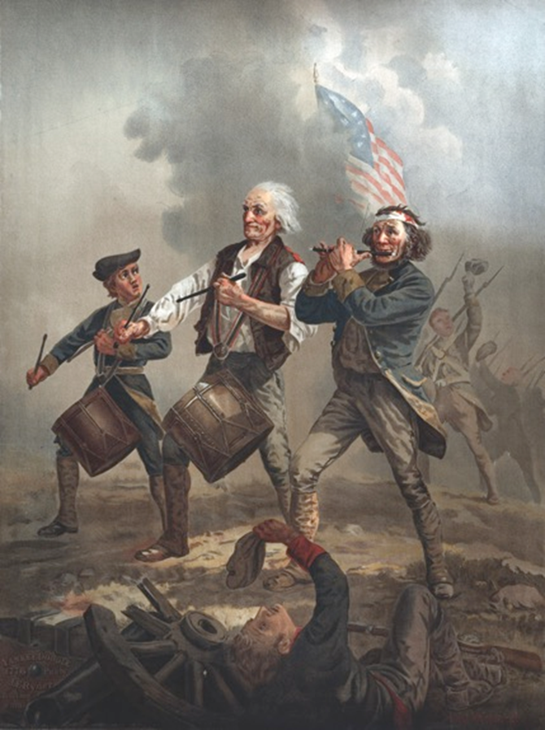
The Influence of the American and French Revolutions
The events of the American and French Revolutions had a big impact on Ireland. Irish troops and newspapers gave the people in Ireland a lot of reports and stories of what was happening. Many Catholics and Presbyterians were attracted to the ideas of liberty and equality.
How British government dealt with Ireland was also affected by these revolutions. During the war in America, for fear that a similar revolt would break out in Ireland, the Irish parliament was given more over its own affairs. During the French Revolution - especially after war was declared on France in 1793 - the British feared feared a full rebellion in Ireland with French support, or even a French invasion to use Ireland as a base from which to attack Britain.
Strand Two: The History of Ireland
Chapter Fourteen: The 1798 Rebellion
Diagram taken from Artefact, 2nd Edition by Eimear Jenkinson and Gregg O'Neill (educate.ie)
@MsDoorley

Slide 15
Checkpoint pg. 159 (Artefact, 2nd Edition)
  What was the Protestant Ascendancy?
  What were the Penal Laws? Give two examples.
  Why was each of the following groups unhappy about its position in Ireland by the 1790s; (a) Anglicans (b) Catholics (c) Presbyterians?
  Why do you think the ideas of the American and French Revolutions appealed to many? Explain your answer.
  Why was the British government worried about the influence of these revolutions on Ireland?
Strand Two: The Nature of History
Chapter Fourteen: The 1798 Rebellion
@MsDoorley

Slide 16
1798
Chapter 14
14.2: THE UNITED IRISHMEN
14.2: the united irishmen
Strand Two: The History of Ireland
@MsDoorley

Slide 17
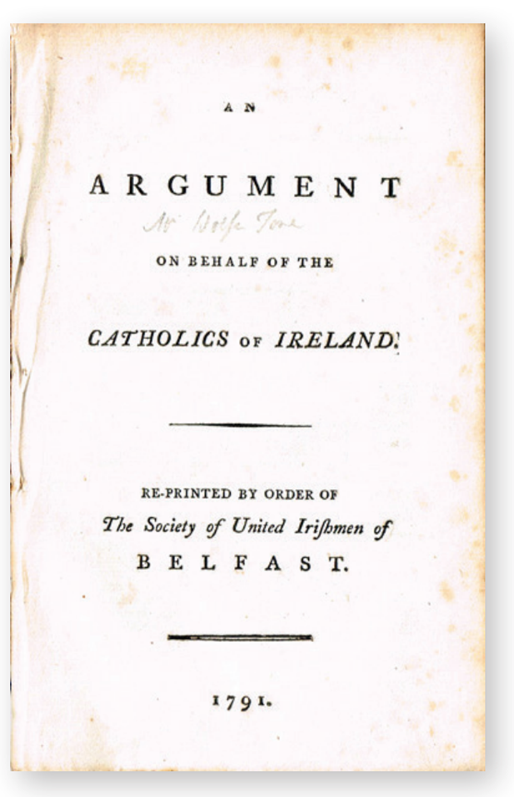
Foundation of the United Irishmen
In 1791, Theobald Wolfe Tone sent out a pamphlet (“An Argument on Behalf of the Catholics of Ireland”) attacking the administration of the Marquess of Buckingham and arguing that Catholics should have the same rights as Protestants. Presbyterians were also interested in the ideas of the French Revolution and invited him to a meeting in Belfast.
This meeting founded the Society of United Irishmen. The other founding members were Samuel Neilson, Henry Joy McCracken, Thomas Russel and William Drennan. Soon a Dublin branch was founded by Napper Tandy and other branches appeared around the country. In January 1792, they began publishing their own newspaper, The Northern Star. Their original aim was a peaceful reform not a violent revolution. They wanted:
  Religious equality
  Removal of British influence from Ireland (but not a full independent republic)
  That all men should have the vote and right to sit in parliament.
Strand Two: The History of Ireland
Chapter Fourteen: The 1798 Rebellion
Diagram taken from Artefact, 2nd Edition by Eimear Jenkinson and Gregg O'Neill (educate.ie)
@MsDoorley

Slide 18
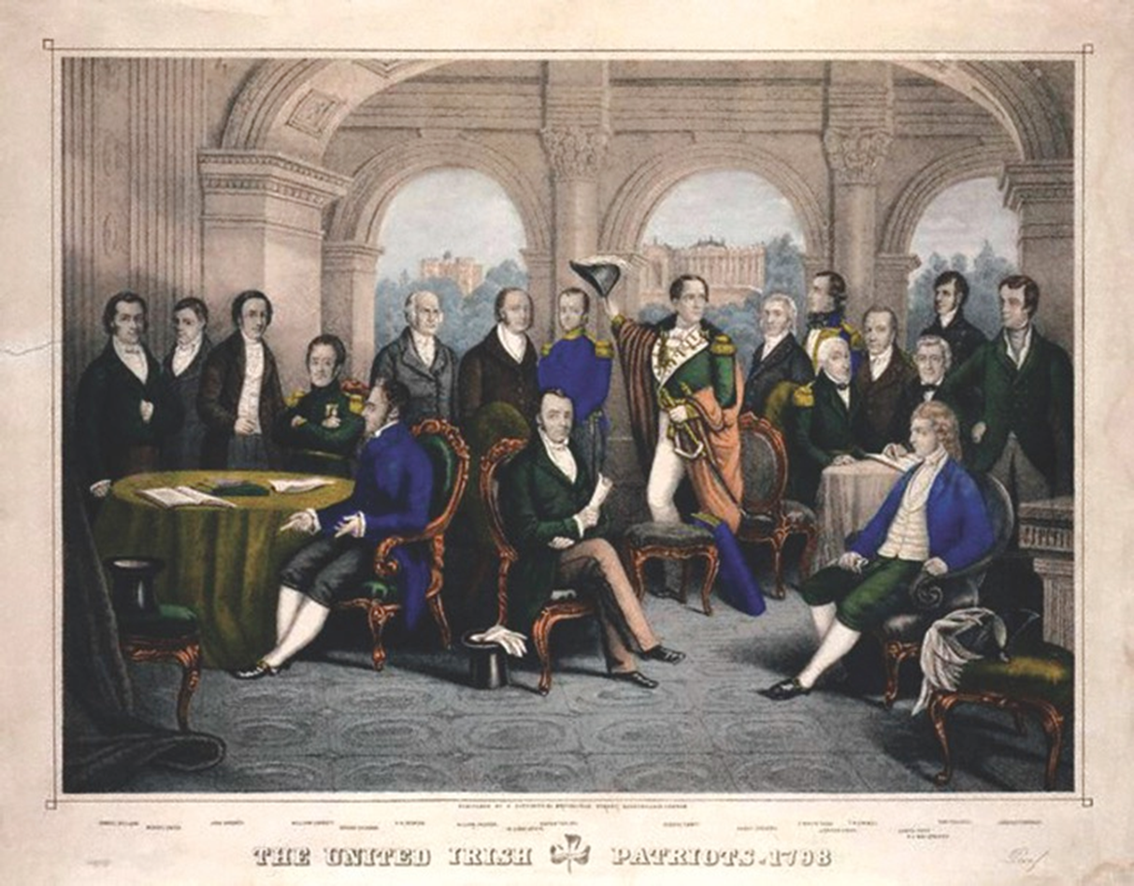
Strand Two: The History of Ireland
Chapter Fourteen: The 1798 Rebellion
Diagram taken from Artefact, 1st Edition by Eimear Jenkinson and Gregg O'Neill (educate.ie)
@MsDoorley

Slide 19
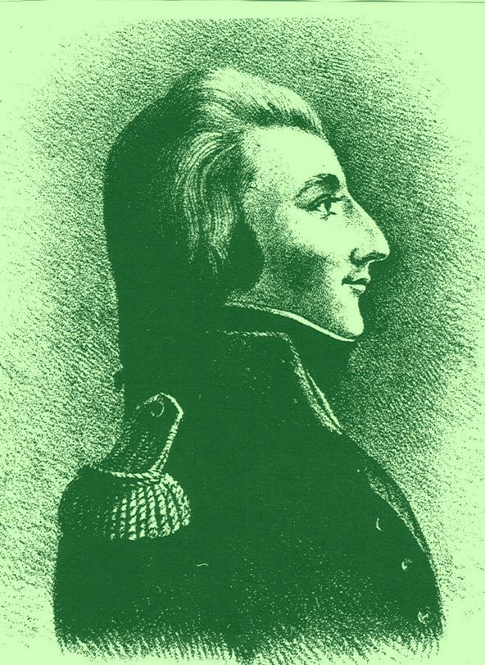
Theobald Wolfe Tone, 1763-1798
Theobald Wolfe Tone was born in Dublin in 1763 to a wealthy middle-class Anglican family. He studied law in Trinity College, qualified as a barrister from King’s Inn and attended Inn’s of court in London. He was inspired by the writers of the Enlightenment and visited Paris in 1789 to witness the events of the French Revolution in its initial stages. Inspired by the ideas of “liberty, equality, fraternity”, he returned to Ireland. He helped to found the United Irishmen in 1791. In 1795, he fled Ireland, fearing arrest, and later went to France to seek help for an invasion of Ireland. This invasion failed in Bantry Bay in 1797. Wolfe Tone returned in 1798, having learned of the United Irishmen's rising. He was captured in Donegal and was sent to trial in Dublin where he was found guilty. He was denied “a soldier’s death” (firing squad). Before he could be hanged, Tone tried to commit suicide by cutting his own throat. He was unsuccessful in a quick death; it would take five days before he died of the wounds. He is considered the “Father of Irish Republicanism” and his ideas inspired generations of Irish republicans to fight for freedom from Britain.
Strand Two: The History of Ireland
Chapter Eleven: The Irish Plantations
Diagram taken from Artefact, 2nd Edition by Eimear Jenkinson and Gregg O'Neill (educate.ie)
@MsDoorley

Slide 20
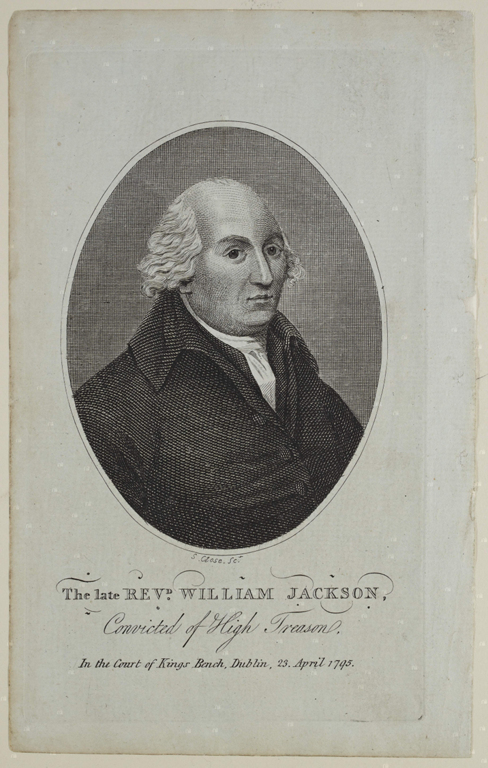
The impact of the war with France
Britain declared war on France in early 1793. Fearing that Catholic resentment in Ireland would lead to a revolution here, the British government decided to make concessions. They abolished most of the remaining Penal Laws, granting Catholics freedom of worship and the right to vote - but Catholics still could not sit in parliament.
The British government in Dublin stepped up its surveillance of groups that it considered a threat, like the United Irishmen. In 1795, a French spy named William Jackson was arrested and he was found to have met with Wolfe Tone, who fled to the USA. The government banned the United Irishmen. It became a secret society that was now committed to a revolution against British rule.
Strand Two: The History of Ireland
Chapter Fourteen: The 1798 Rebellion
@MsDoorley

Slide 21
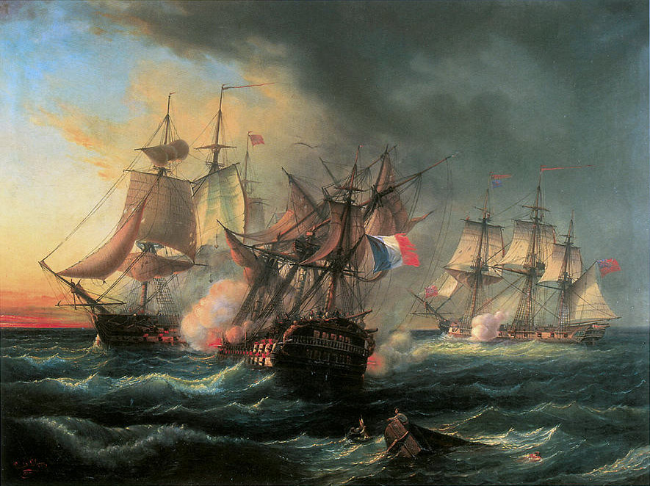
Wolfe Tone in France and Bantry Bay
Tone travelled to France in 1796 to seek military support for an Irish rebellion. The French sent 43 ships and 15,000 men under General Hoche but storms ensured only 14 reached the landing point of Bantry Bay in Co. Cork. Several days of trying to land in the terrible weather, meant that the ships turned back. This left Tone bitterly disappointed – “England has not had such an escape since the Spanish Armada”.
Strand Two: The History of Ireland
Chapter Fourteen: The 1798 Rebellion
@MsDoorley

Slide 22
The governments' response
The near miss of the French invasion horrified the governments in London and Dublin. They quickly took steps to destroy the United Irishmen and their network.
  In late 1798, General Lake landed in Ulster, where his soldiers went from town to town demanding any weapons or information that people had. Lake's men used several tactics to get what they wanted. They burned houses, flogged (whipped), beat, tortured and even executed anyone they believed to be involved. Some were given half-hangings (hanging a person until they were almost dead to extract information). Others had pitch-capping (pouring hot tar on a person’s head before setting it on fire. When the tar cooled, they ripped it - and the top of the scalp - off). These horrific measures were designed to terrify people in order to reduce support for a rebellion. They were repeated throughout Leinster.
  Part-time armies were formed: the militia for loyal Catholics and yeomanry for loyal Protestants.
  The Orange Order was created to encourage unity between Anglicans and Presbyterians against Catholics
  Spies inside the United Irishmen passed on information that led to the arrest of most United Irishmen leaders. Most significantly, Lord Edward FitzGerald who was captured in May 1798. The remaining leaders decided to go ahead with the rebellion a week later, on 23rd May 1798.
Strand Two: The History of Ireland
Chapter Fourteen: The 1798 Rebellion
@MsDoorley

Slide 23
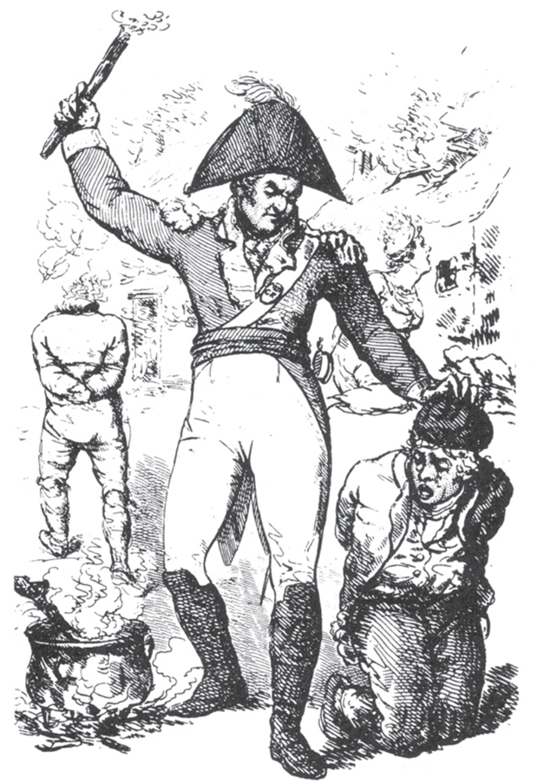
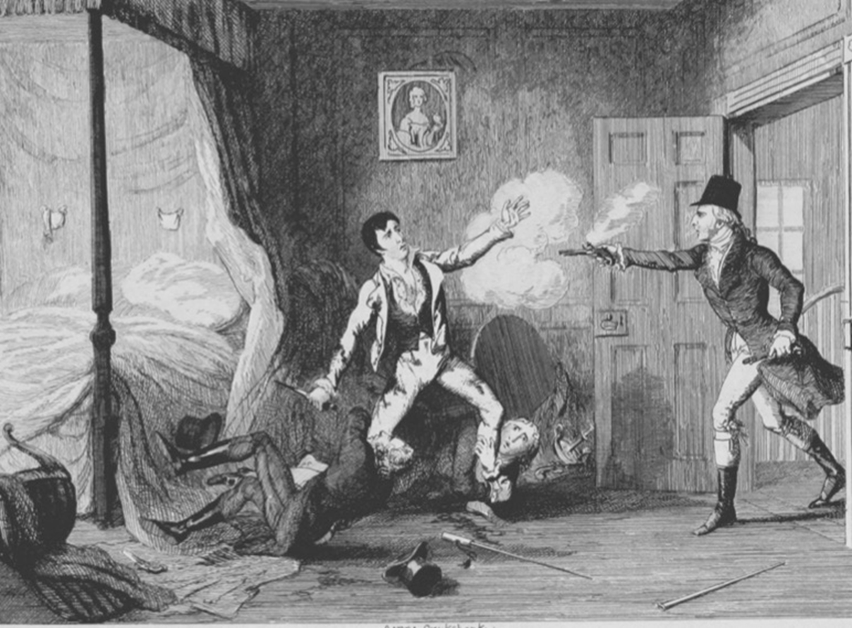
Strand Two: The History of Ireland
Chapter Fourteen: The 1798 Rebellion
Diagram taken from Artefact, 2nd Edition by Eimear Jenkinson and Gregg O'Neill (educate.ie)
@MsDoorley

Slide 24
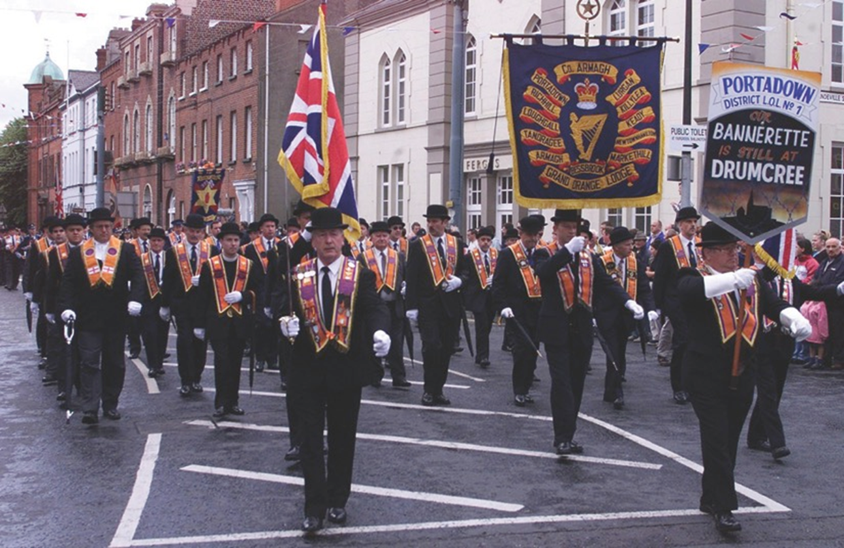
Strand Two: The History of Ireland
Chapter Fourteen: The 1798 Rebellion
Diagram taken from Artefact, 2nd Edition by Eimear Jenkinson and Gregg O'Neill (educate.ie)
@MsDoorley

Slide 25
Checkpoint pg. 29 (Artefact, 2nd Edition)
  How was Tone influenced by the French Revolution?
  What pamphlet did he write and what did he argue in it?
  What were the original aims of the United Irishmen?
  How did the governments respond to concerns over (a) Catholics’ loyalty and (b) France and the United Irishmen?
  What help did Tone get from France?
  How did the British government respond to the failed invasion at Bantry Bay?
Strand Two: The Nature of History
Chapter Fourteen: The 1798 Rebellion
@MsDoorley

Slide 26
Checkpoint pg. 29 (Artefact, 2nd Edition)
  Tone was inspired by the French Revolution’s ideas of ‘liberty, equality and fraternity’ and wanted to bring them to Ireland.
  He wrote An Argument on behalf of the Catholics of Ireland, which argued that Catholics should have the same rights as Protestants.
  The United Irishmen originally wanted religious equality, the removal of British influence from Ireland (though not an independent republic) and that all men should have the vote and the right to sit in parliament.
  (a) The British government abolished the remaining Penal Laws and granted Catholics freedom of worship and the right to vote; (b) The British government in Dublin stepped up its surveillance of the United Irishmen and eventually banned them in 1795.
  The French sent a fleet of 43 ships and an army of 15,000 men to invade Ireland in December 1796, but most had to turn back due to storms.
  Any two of: General Lake’s campaign of terror in Ulster and Leinster; the infiltration of the United Irishmen by spies and the arrest of the leaders; the setting up of the militia and yeomanry; the support for the Orange Order.
Strand Two: The Nature of History
Chapter Fourteen: The 1798 Rebellion
@MsDoorley

Slide 27
1798
Chapter 14
14.3: THE 1798 REBELLION
14.3: the 1798 rebellion
This rebellion is significant in Irish history as it was the first time that physical force nationalism occurred on the island (Irish nationalists were willing and prepared to use violence to fight for complete Irish independence from Britain). The main events of the Rebellion took place in Leinster (Dublin), Ulster, Wexford and Connaught.
Strand Two: The History of Ireland
@MsDoorley

Slide 28
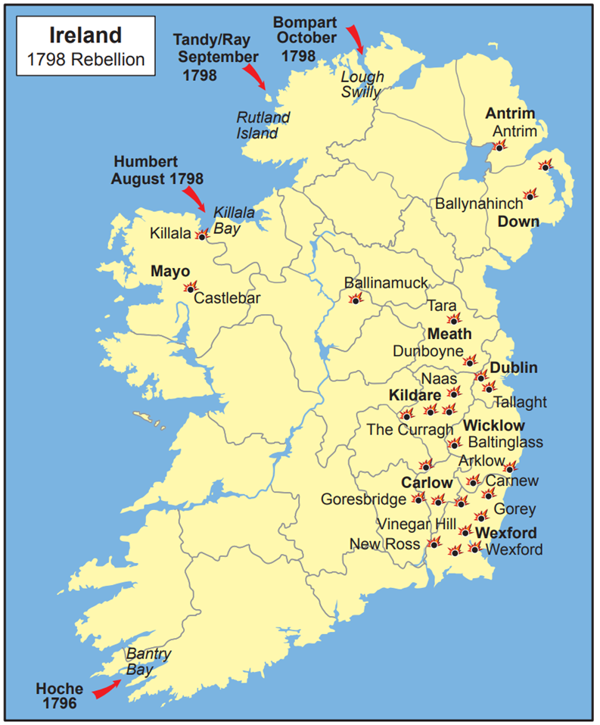
Leinster - Dublin
The rebels had planned that the rebellion would begin with the disruption of mail coaches from Dublin. However, information gathered by spies led to many rebels being arrested when they arrived at their assembly points. There were uncoordinated rebel attacks in Kildare, Meath, Carlow and Wicklow but were easily defeated at Carlow Town and the Hill of Tara.
Strand Two: The History of Ireland
Chapter Fourteen: The 1798 Rebellion
Diagram taken from Artefact, 2nd Edition by Eimear Jenkinson and Gregg O'Neill (educate.ie)
@MsDoorley

Slide 29
Ulster
Although Ulster had been a United Irishmen stronghold, after the intimidation, torture, jailing and executions in the province, support for the secret group weakened. Because of this, the rebellion that took place there (mainly consisting of Presbyterians) was small in comparison to what happened in Wexford. In Antrim, Henry Joy McCracken led 4,000 rebels into battle on the 6th June, succeeding in capturing Larne, Randalstown and Ballymena before being defeated after a fierce battle at Antrim town. In Down, Henry Munro led 7,000 rebels who to initial success at Saintfield but they could not match the army’s cannons at Ballynahinch. Both McCracken and Munro were later separately captured and hanged.
Strand Two: The History of Ireland
Chapter Fourteen: The 1798 Rebellion
@MsDoorley

Slide 30
Wexford
In March 1798, British soldiers, yeomen and the North Cork militia entered Wexford. Their violent treatment of the locals created a determination to resist that led to a Catholic priest, Fr John Murphy of Boolavogue leading a revolt. They had victories at Oulart Hill, Enniscorthy and Wexford (where United Irishman Bagenal Harvey was freed from jail) before their growing army of 15,000 was defeated at the Battles of New Ross and Arklow. The main force of the rebels, including their leaders, was surrounded and defeated by General Lake at Vinegar Hill on 21 June. Some days later, both Bagenal Harvey and Fr John Murphy were captured and executed while harsh reprisals were carried out against areas that had supported the rebels.
Wexford saw the only atrocities committed by the rebels during the 1798 Rebellion. Some 200 Protestants were burned alive in a barn at Scullabogue and another 100 were massacred in Wexford town. In Wexford, there was deep bitterness at the Penal Laws that was exacerbated by the harsh treatment of Catholics by the Protestant yeomen which led to directed retaliations by the rebels against the local Protestant population. The actions of the Wexford rebels would taint the rebellion for Ireland’s Protestants.
Strand Two: The History of Ireland
Chapter Fourteen: The 1798 Rebellion
@MsDoorley

Slide 31
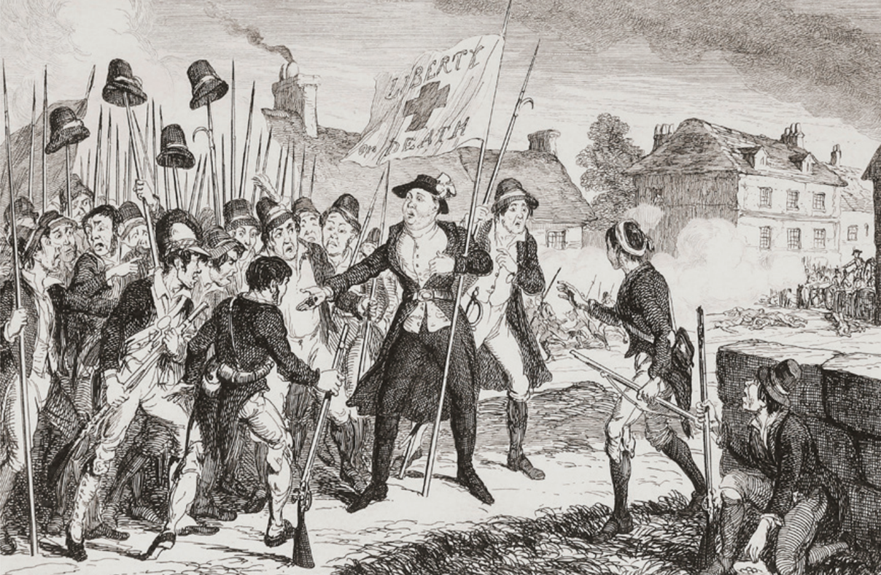
Strand Two: The History of Ireland
Chapter Fourteen: The 1798 Rebellion
Diagram taken from Artefact, 2nd Edition by Eimear Jenkinson and Gregg O'Neill (educate.ie)
@MsDoorley

Slide 32
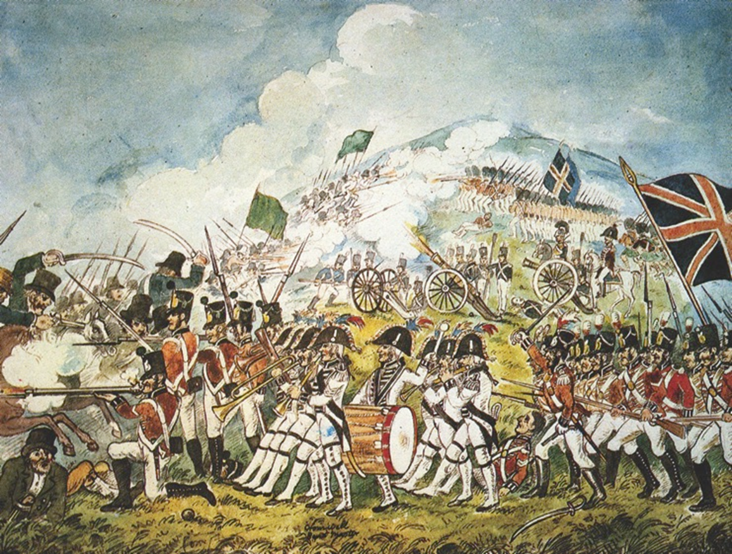
Strand Two: The History of Ireland
Chapter Fourteen: The 1798 Rebellion
Diagram taken from Artefact, 1st Edition by Eimear Jenkinson and Gregg O'Neill (educate.ie)
@MsDoorley

Slide 33
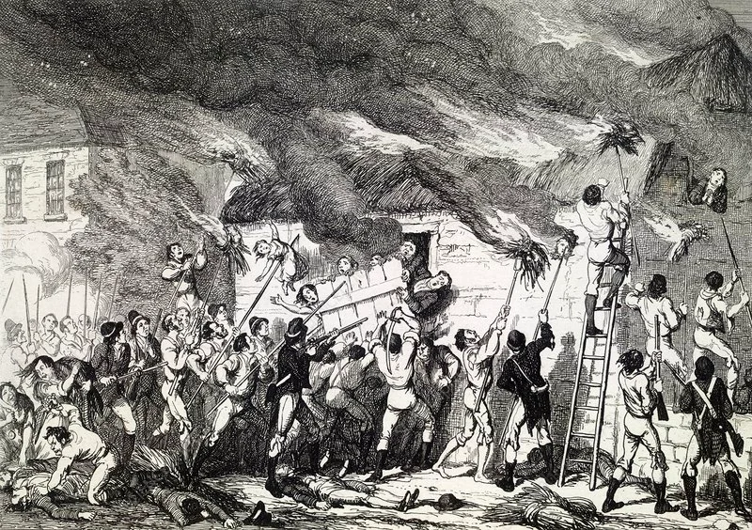
Strand Two: The History of Ireland
Chapter Fourteen: The 1798 Rebellion
Diagram taken from Artefact, 2nd Edition by Eimear Jenkinson and Gregg O'Neill (educate.ie)
@MsDoorley

Slide 34
Irish Rebel Song - Boolavogue
At Boolavogue, as the sun was setting
O'er the bright May meadows of Shelmalier,
A rebel hand set the heather blazing
And brought the neighbours from far and near.
Then Father Murphy, from old Kilcormack,
Spurred up the rock with a warning cry;
'Arm! Arm!' he cried, 'for I've come to lead you,
For Ireland's freedom we fight or die.'
He led us on 'gainst the coming soldiers,
And the cowardly Yeomen we put to flight;
'Twas at the Harrow the boys of Wexford
Showed Bookey's Regiment how men could fight
Look out for hirelings, King George of England,
Search ev'ry kingdom where breathes a slave,
For Father Murphy from the County Wexford
Sweeps o'er the land like a mighty wave.
At Vinegar Hill, o'er the pleasant Slaney,
Our heroes vainly stood back to back,
And the Yeos at Tullow took Father Murphy
And burned his body upon the rack.
God grant you glory, brave Father Murphy
And open heaven to all your men;
The cause that called you may call tomorrow
In another fight for the Green again
Strand Two: The History of Ireland
Chapter Fourteen: The 1798 Rebellion
https://www.youtube.com/watch?v=qQwC2uQBDYQ - The High King's cover of Boolavogue
@MsDoorley

Slide 35
Working with Sources
  Who was Father Murphy and what role did he play in the 1798 Rebellion?
  How is Father Murphy portrayed in the song "Boolavogue"?
  What happened at Boolavogue and Vinegar Hill?
  Who were the Yeomen referred to in the song, and how were they involved in the 1798 Rebellion?
  What symbolism is used in the Song?: Identify one symbol or image in the song (e.g., the heather blazing, the Green) and explain what you think it represents.
  According to the song, what assistance or leadership did the rebels receive?
  What happened to Father Murphy and the other rebels by the end of the song? How does the song express hope or warning for the future?
Strand Two: The Nature of History
Chapter Fourteen: The 1798 Rebellion
@MsDoorley

Slide 36
Working with Sources (Answers)
  Father John Murphy was a Catholic priest from County Wexford, Ireland. He played a significant role in the 1798 Rebellion, leading insurgents in Wexford and winning key battles. Initially reluctant to join the rebellion, he became involved after the local yeomen attacked his area. He became a symbol of resistance and was eventually captured and executed.
  In "Boolavogue," Father Murphy is portrayed as a brave and inspirational leader. He is depicted rallying the people, leading them against the soldiers, and being a symbol of Irish freedom. The song celebrates his efforts and memorializes him as a hero of the cause.
  Boolavogue was the site of an early victory for the rebels, where Father Murphy led them against the British forces. Vinegar Hill was the location of a significant battle where the rebels made a stand but were eventually defeated by the British Army. The song captures the valiant effort at Vinegar Hill but also acknowledges the loss.
  The Yeomen were a local militia made up of property owners and their employees, loyal to the British Crown. In the 1798 Rebellion, they were often responsible for suppressing the rebellion and were notorious for their brutal tactics. In "Boolavogue," they are depicted as "cowardly," reflecting the rebel's view of them.
  The symbol of the heather blazing can represent the ignition of the rebellion, a spark that brought neighbours from far and near together. It may symbolize the burning desire for freedom and the passion of the Irish people during the rebellion.
  The song emphasizes the leadership of Father Murphy, who spurred the rebels with a warning cry and led them against the soldiers. His rallying cry of "Arm! Arm!" symbolized the call to action and resistance. The song doesn't mention specific external assistance, focusing instead on local efforts.
  The song narrates the capture and execution of Father Murphy, burned "upon the rack." It acknowledges the defeat at Vinegar Hill but ends with a note of hope, praying for glory for Father Murphy and open heaven for his men. It also hints at the possibility of future fights for "the Green again," perhaps symbolizing both a warning of ongoing struggle and a hope for eventual victory.
Strand Two: The Nature of History
Chapter Fourteen: The 1798 Rebellion
@MsDoorley

Slide 37
French Help Arrives: Connaught
Tone had been in France since the failed Bantry Bay landing of 1796. Two months after the failures in Leinster, Wexford and Ulster, the French sent 1,000 troops under General Humbert to Killala, Co. Mayo. He beat back General Lake’s men in what became known as the Races of Castlebar because the soldiers fled so quickly, leaving many of their weapons behind. Humbert was eventually defeated near Ballinamuck, Co. Longford by a reinforced British army led by General Lake and General Cornwallis. Although the captured French troops were allowed to return home, the captured Irish rebels were hanged.
A final attempt to land more French troops was made in October. 3,000 soldiers sailed to Donegal, led by Admiral Bompart, but were captured by the British navy at Lough Swilly.
Tone was on board one of the ships and was captured. He was sent to trial in Dublin where he was found guilty. He was denied “a soldier’s death” (firing squad). Before he could be hanged, Tone tried to commit suicide by cutting his own throat. He was unsuccessful in a quick death; it would take five days before he died of the wounds.
Strand Two: The History of Ireland
Chapter Fourteen: The 1798 Rebellion
@MsDoorley

Slide 38
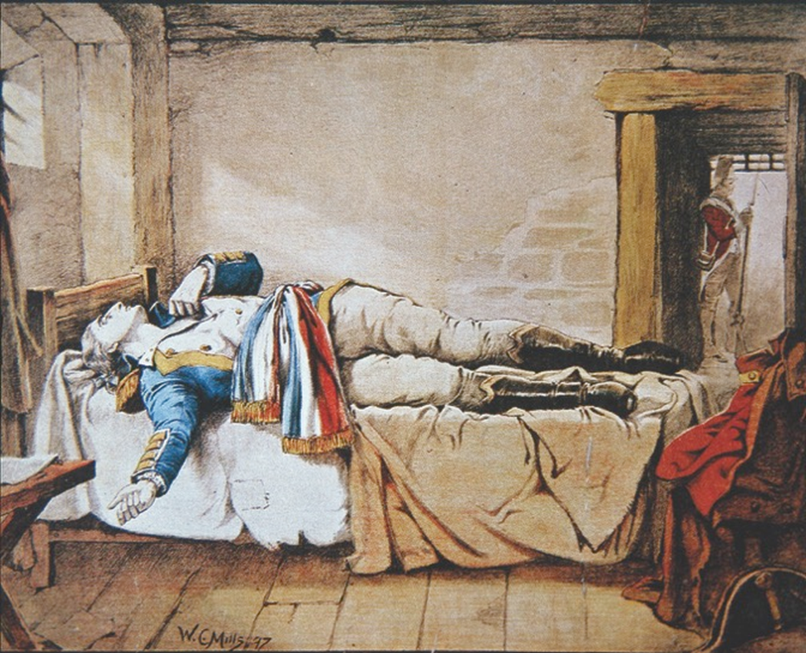
Strand Two: The History of Ireland
Chapter Fourteen: The 1798 Rebellion
Diagram taken from Artefact, 2nd Edition by Eimear Jenkinson and Gregg O'Neill (educate.ie)
@MsDoorley

Slide 39
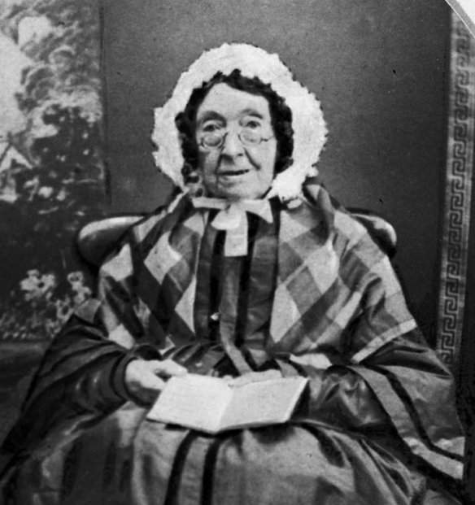
Mary Ann McCracken, 1770-1866
Mary Ann McCracken was born into a large Presbyterian family in Belfast. She went to a co-educational school (very unusual for the time), where boys and girls were treated equally. She ran her own successful muslin cloth business in Belfast. Her brother Henry was a leading member of the United Irishmen, which she actively supported. She hid him after the Battle of Antrim and, after he was arrested and convicted, she accompanied him to the gallows for his hanging. She shared his radical beliefs. After the rebellion, she campaigned for various social causes. She raised funs for the children of Belfast Poorhouse and formed the Ladies Committee of the Belfast Charitable Society and was chair from 1832 to 1855. She led the efforts to set up a school and a nursery for the orphans of Belfast. She also campaigned to the abolition of slavery, chairing the Women's Abolition Committee in Belfast. At the age of 88, she was still regularly handing out anti-slavery leaflets on the Belfast docks to those boarding ships bound for the United States.
Strand Two: The History of Ireland
Chapter Eleven: The Irish Plantations
Diagram taken from Artefact, 2nd Edition by Eimear Jenkinson and Gregg O'Neill (educate.ie)
@MsDoorley

Slide 40
Why did the United Irishmen's rebellion fail?
The rebels were badly organised and trained
They had few decent weapons; mainly using long pikes against British rifles
They received no useful French help
They were infiltrated by British spies
They faced much stronger government forces
They suffered a series of misfortune and back luck.
The British used brutal tactics to intimidate any supporters.
Strand Two: The History of Ireland
Chapter Fourteen: The 1798 Rebellion
@MsDoorley

Slide 41
Checkpoint pg. 164 (Artefact, 2nd Edition)
  What was the signal for the start of the rebellion?
  Why did the Dublin rebels fail so quickly?
  What happened to the rebellion in Ulster?
  How was the rebellion in Wexford different from those in other areas? Give two examples.
  Is it correct to describe the French help as “too little, too late”? Explain your answer.
  Which reason for the rebellion’s failure do you think is the most important? Explain your answer.
Strand Two: The Nature of History
Chapter Fourteen: The 1798 Rebellion
@MsDoorley

Slide 42
Checkpoint pg. 164 (Artefact, 2nd Edition)
  The disruption of the mail coaches from Dublin.
  Spies had passed on information on the rebellion and the rebels were arrested when they arrived at their assembly points.
  The rebels in Ulster were defeated in battles at Antrim and Ballynahinch.
  Any two of: the rebels were better organised; won the initial battles with the government troops; the sectarian killings of Protestants.
  Yes. The French only sent about 1,000 troops; they arrived in Mayo, far from the action and in August, when the rebellion was already over.
  Any reason is valid once it is backed up by examples and explanation.
Strand Two: The Nature of History
Chapter Fourteen: The 1798 Rebellion
@MsDoorley

Slide 43
1798
Chapter 14
RESULTS OF THE 1798 REBELLION
results of the 1798 rebellion
Strand Two: The History of Ireland
@MsDoorley

Slide 44
Growth of sectarianism
Sectarianism is the conflict and hatred based on a religious divide. The events of 1798 cemented the divide in Ireland between Catholics and Protestants (both Anglicans and Presbyterians). News of the rebels’ atrocities against the Protestants in Wexford spread. The Orange Order claimed that the rebellion was a Catholic plot to take over the country and oppress all Protestants (they didn’t like the idea of suffering like the Catholics had since the Irish Plantations). This belief would continue throughout the rest of Irish history.
Strand Two: The History of Ireland
Chapter Fourteen: The 1798 Rebellion
@MsDoorley

Slide 45



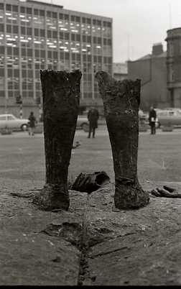

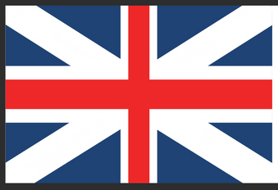
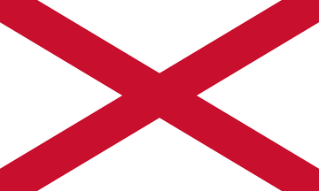
The Act of Union
After two attempted French invasions and a failed rebellion, the government in London decided to bring Ireland back under its direct control. Using a mixture of bribery and threats, it forced the Dublin Parliament to pass the Act of Union in 1800, which abolished the parliament in Dublin while Irish MPs were to travel to Westminster where Ireland would be run from for the next 120 years. Before the Union, Dublin had been a prosperous city of great importance in the British Empire. After the Union, as the political classes moved to London and trade shifted to Belfast, Dublin became a poor, unglamorous backwater.
Strand Two: The History of Ireland
Chapter Fourteen: The 1798 Rebellion
Did you know?
One February morning in 1971, the Ulster Defence Association blew up the statue of Wolfe Tone at the corner of St. Stephen's Green in Dublin, showing the considerable symbolic value he still held over 170 years after his death.
England
Scotland
Original Union Flag (1606)
Ireland
Current Union Jack (1801)
Diagram taken from Artefact, 2nd Edition by Eimear Jenkinson and Gregg O'Neill (educate.ie)
@MsDoorley

Slide 46
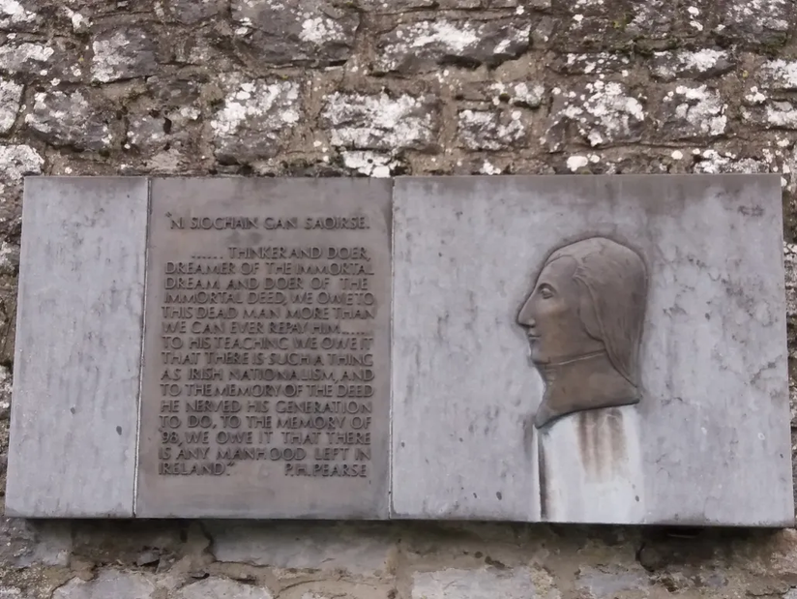
Irish Republicanism
Despite the failed rebellion, Tone’s dream of an independent Irish republic based on equality between Catholics and Protestants would inspire many over the next 200 years. Tone became known as the “Father of Irish Republicanism” and his ideas inspired: Robert Emmet in 1803, The Young Irelanders in 1848 (‘Year of Revolutions’ throughout Europe), and the Fenians in 1867, as well as the leaders of the Easter Rising in 1916.
Strand Two: The History of Ireland
Chapter Fourteen: The 1798 Rebellion
Diagram taken from Artefact, 2nd Edition by Eimear Jenkinson and Gregg O'Neill (educate.ie)
@MsDoorley

Slide 47
Checkpoint pg. 165 (Artefact, 2nd Edition)
  What is sectarianism?
  How did the 1798 Rebellion lead to sectarian divisions in Ireland?
  What was the Act of Union?
  Why did the British government want the Act of Union?
  How did the Act of Union affect Dublin?
  What impact did Tone have on Irish history?
Strand Two: The Nature of History
Chapter Fourteen: The 1798 Rebellion
@MsDoorley

Slide 48
Checkpoint pg. 165 (Artefact, 2nd Edition)
  Sectarianism: conflict and hatred based on a religious divide.
  The atrocities in Wexford fed fears that Catholics were plotting to take over the country and oppress Protestants.
  The Act of Union abolished the Irish parliament and meant that Irish MPs would sit in Westminster instead.
  The British wanted greater control over Ireland to ensure that there would be no future rebellions.
  Dublin went into a decline as many of its wealthy citizens relocated to London and much of its trade shifted to Belfast.
  Wolfe Tone was the founder of the physical force republican tradition, which believed that force would be necessary to win an independent Irish republic from Britain.
Strand Two: The Nature of History
Chapter Fourteen: The 1798 Rebellion
@MsDoorley

Slide 49
1798
Chapter 14
14.6: SUMMARY
14.6: summary
Strand Two: The History of Ireland
@MsDoorley

Slide 50
In this chapter, we have learned that...
The causes of the 1798 Rebellion can be divided into long term and short term causes:
Long-term Casues | Short-Term Causes
The Protestant (Anglican) Ascendancy | The United Irishmen
Discrimination against Catholics and Presbyterians | War between Britain and revolutionary France
The influence of the American and French Revolutions | Failed invasion at Bantry Bay
 | The repression after Bantry Bay
  The rebellion was a military disaster. The rebels failed to take Dublin or even stop the mail coaches. The government quickly crushed the rebels in battle in Meath, Carlow, Antrim and Down.
  The rebels in Wexford had more success initially, when they seized Enniscorthy and Wexford town. They were defeated at Vinegar Hill – but not before they had slaughtered hundreds of Protestants. French help arrived after the Rebellion was already over.
  The United Irishmen had fought for an independent Irish republic which would unite Catholics and Protestants. Their defeat actually saw the end of the Irish parliament and worsened religious divisions on the island.
  The ideas of Tone inspire later generations to fight for the same cause until Irish independence was finally achieved in 1921.
Strand Two: The History of Ireland
Chapter Fourteen: The 1798 Rebellion
@MsDoorley

Slide 51
Reflecting on... the 1798 Rebellion
The 1798 Rebellion had profound consequences for Ireland. It opened the door to the use of violence to achieve political ends and forged a link between the cause of Irish freedom and violent revolution. It is a bitter irony that the sectarianism that has plagued the island for over 200 years found much of its origins in a rebellion by a group created to overcome those very differences.
Strand Two: The History of Ireland
Chapter Fourteen: The 1798 Rebellion
@MsDoorley

Slide 52
SEC Examination Questions
2022 SEC Q4
Strand Two: The History of Ireland
Chapter Fourteen: The 1798 Rebellion
@MsDoorley

Slide 53
Project
Guidelines:
  Length: The depth of your project should reflect about 2-3 weeks of work.
  Sources: Use at least three different sources for your research. These can be books, scholarly articles, or reputable online resources.
  Citations: All information and images that are not your own should be properly cited.
  Mediums: You may choose to present your project in one of the following ways:
    Poster: Your poster should be informative and visually engaging.
    Minecraft or Lego Model: If choosing this option, please also include a brief report explaining your model.
    Painting/Drawing: Your artwork should be accompanied by a description.
    Recycled Materials: Create your model using recycled materials and provide an explanation of your creative process.
Assessment:
Your projects will be assessed based on:
  Research and Content
  Creativity and Presentation
  Understanding of Context
  Adherence to Guidelines
Strand Two: The History of Ireland
Chapter Fourteen: The 1798 Irish Rebellion
@MsDoorley

Slide 54
Project
Historical Sites
Historical Figures
Vinegar Hill Battlefield, Enniscorthy, County Wexford
Humbert Monument, Castlebar, County Mayo
The Old Courthouse, Antrim, County Antrim
Arklow Maritime Museum, Arklow, County Wicklow
Sean MacDiarmada Homestead, Kiltyclogher, County Leitrim
Theobald Wolfe Tone
Father John Murphy
Henry Joy McCracken
Robert Emmet
James Stephens
Lord Edward Fitzgerald
Bagenal Harvey
Henry Munro
William Smith O’Brien
General Hoche
General Humbert
Michael Dwyer
John Mitchel
Thomas Francis Meagher
Strand Two: The History of Ireland
Chapter Fourteen: The 1798 Irish Rebellion
@MsDoorley

